Slide 1
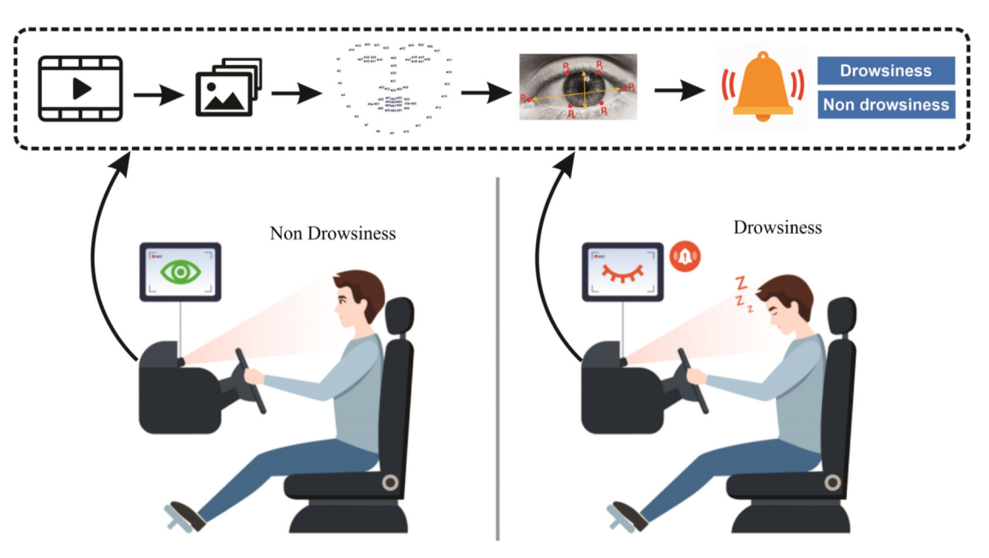
DRIVER DROWSINESS DETECTION
Student’s Name: 2200100012-K. Srija 2200100060-K. Hemanth Kumar 2200100067-V. Vishnu Kumar Course Name and Number: Term Paper- 22IE3043 Instructor’s Name: Mr. Eswar Date of Submission:

Slide 2
Introduction
Drowsy driving is a major cause of road accidents worldwide, leading to thousands of crashes, injuries, and fatalities each year. It occurs when drivers experience fatigue due to lack of sleep, long hours on the road, certain medications, or irregular work schedules. Sleep deprivation slows reaction time, impairs judgment, and increases the risk of serious collisions. Night shift workers, long-distance drivers, and individuals with sleep disorders are particularly vulnerable. To prevent drowsy driving, it is crucial to get enough rest, take regular breaks, avoid driving during late-night hours, and recognize early signs of fatigue such as yawning, drifting between lanes, or difficulty focusing. Modern vehicles are now equipped with drowsiness detection systems, lane departure warnings, and adaptive cruise control to enhance road safety. Raising awareness and adopting preventive measures can help reduce accidents and make roads safer for everyone.

Slide 3
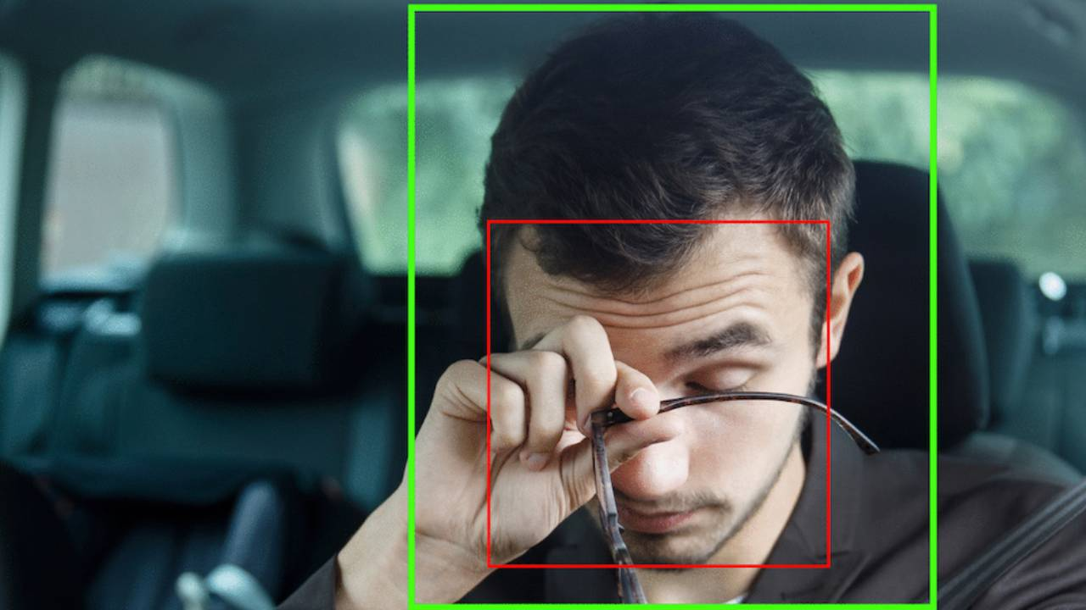
Literature Review
Overview of Existing Research:
Existing research on driver drowsiness detection has explored various techniques aimed at identifying fatigue in real-time to prevent road accidents. Recent studies have shown promising results by integrating multiple techniques and applying machine learning and deep learning algorithms for better accuracy. These methods are broadly categorized into behavioral-based, physiological-based, and vehicle-based approaches
Key Theories and Studies : Focuses on analyzing facial features like eye blinking, yawning, and head movements. Uses computer vision and deep learning models (e.g., CNNs) for real-time fatigue detection. Studies have used algorithms like SVM, CNN, and LSTM to improve detection accuracy.

Slide 4
Gaps in the Literature :
Drowsiness signs like eye blinking or yawning vary between individuals, making it hard to design a one-size-fits-all solution. Computer vision-based methods often fail in low-light conditions or when the driver’s face is partially covered. High-accuracy models often require powerful hardware, making them unsuitable for deployment in budget vehicles. Lack of Real-World Testing many existing studies are conducted in controlled environments or simulators, which do not fully represent real driving conditions.

Slide 5
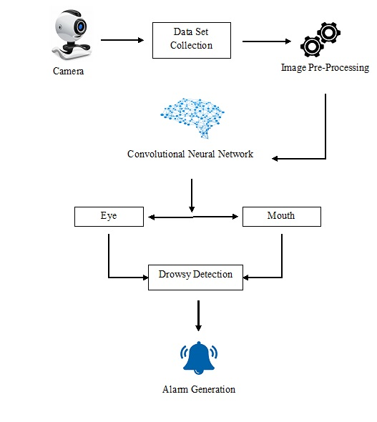
Methodology
1. Data Collection Collected real-time video data of drivers under various states (awake, drowsy, yawning, eye closure). Public datasets like YawDD, NTHU Drowsy Driver, or custom dataset used via webcam/IoT camera. 2. Preprocessing Frame extraction from video in real-time. Face and eye detection using Haar Cascades / Dlib / MTCNN. Image normalization (resizing, grayscale conversion, etc.). Annotation of drowsiness states (closed eyes, yawning, head tilt). 3. Feature Extraction Facial landmarks detection (eye aspect ratio, mouth opening). Temporal pattern tracking (blinks, eye closure duration). Optional: EEG or steering input via IoT devices for multi-modal detection.

Slide 6
4. Model Development Deep Learning models used: CNN, LSTM, or hybrid CNN-LSTM. Trained on labeled images to classify drowsy vs. non-drowsy states. Model fine-tuned with dropout, data augmentation for better generalization. 5. Integration with IoT Deployment on Raspberry Pi or ESP32-CAM for real-time monitoring. Sensors (e.g., IR for eye tracking, accelerometer for head nod detection). IoT dashboard or mobile app to display driver status and alerts. 6. Real-Time Drowsiness Detection Continuous video streaming. Real-time inference with low-latency DL model. Alert generation (buzzer, vibration, SMS) upon drowsiness detection. 7. Evaluation & Testing Performance metrics: Accuracy, Precision, Recall, F1-score. Real-world testing in driving simulators or car environments.

Slide 7
Conclusions
Driver drowsiness detection systems play a critical role in enhancing road safety by identifying signs of fatigue before they lead to serious accidents. With the growing number of road mishaps linked to drowsy driving, the development of intelligent monitoring systems has become more important than ever. Various approaches, including behavioral analysis, physiological signal monitoring, and vehicle-based pattern recognition, have shown promising results.

Slide 8
Future Work
Multimodal Sensor Fusion Combine camera-based analysis with EEG, heart rate, or steering behavior sensors for more accurate detection. Night-Time and Low-Light Detection Enhance vision algorithms for reliable performance in low-light or nighttime driving using IR cameras or thermal imaging. Driver Distraction Detection Extend the system to detect other forms of driver distraction such as phone usage, looking away, or hands off the wheel.

Slide 9
Thank You

